Slide 1

Sant Gajanan Maharaj College Of Engineering
Project Topic Selection
Automatic Headlight Controller
Mr. Gunde Amey Rajendra Mr. Takkekar Aniket Tukaram Mr. Mutnale Sanket Basavraj
Guide
Prof. S. R. Sankpal
Electronics And Telecommunication
HOD
Prof. A. B. Farakte
Electronics And Telecommunication

Slide 2

Outline:
Problem Statement
Introduction
Objective
Block Diagram
Flowchart
Working
Conclusion

Slide 3
Problem Statement:
Design and develop an automatic headlight controller system that enhances road safety by intelligently adjusting the brightness of a vehicle's headlights based on real-time environmental conditions and driving scenarios.

Slide 4
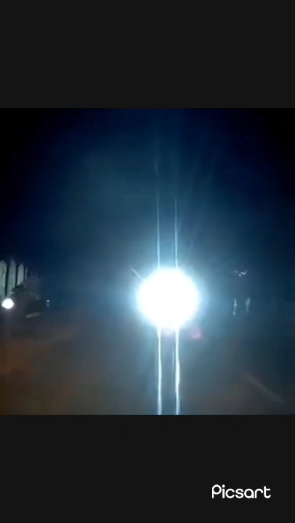

Slide 5
Introduction:
Safety Concerns
Environmental Impact
Manual Adjustments
Traditional Headlight Control
Technological Advancements

Slide 6
Objective:
Safety Enhancement
Energy Efficiency
User Convenience
Improve Visibility

Slide 7
Block Diagram:
Power Supply
LED Drivers
Light
Detect
Sensor
LED
Controller

Slide 8
Flow Chart
Signal From Sensor
Analysis
YES
Light Detection
NO
Dipper
Upper

Slide 9

Working:
Light Detect By Sensor
Controller will Analyze Light Intensity
Command to Driver
High Beam To Low Beam

Slide 10
Conclusion:
Automatic headlight intensity beam is controlled by using sensors. The design gives the solution for night temporary blindness which is caused by high beam headlight intensity.
So, the Accidents can be reduced during night time so people can travel safely in night time. It is very cost effective and high-performance system

Slide 11

THANK YOU…

